Slide 1
Lightweight Approximate Multiplier with Improved Accuracy in FPGA for Error Resilient Application
Mr. Apurba Prasad Padhy, Dr. Bishnu Prasad Das
https://ieeexplore.ieee.org/document/10089951
Presented By: Akarshi Roy Choudhury

Slide 2
APPROXIMATE COMPUTING
Used in error resilient operations like signal processing, image processing
Achieve high performance and efficiency
Multiplication - a fundamental operation in such applications

Slide 3
LACUNAE AND PROBABLE SOLUTION
Machine learning and image processing applications work on large-scale multiplication.
APPROXIMATE MULTIPLIER
The DSP-based multipliers are unable to provide such high speed and latency. Thus, they can’t provide as much efficiency as expected.
SOLUTION
DSP(digital signal processing) blocks in FPGA are employed for fast multiplication.

Slide 4
APPROXIMATE MULTIPLIER
For applications requiring fast multiplication, high performance and area efficient approximate multipliers can be used, instead of accurate multipliers.
FPGA-based 4x4 approximate multiplier using 12 LUTs and one carry chain, has been proposed earlier.
However, there are many error cases, which lead to a significant decrease in accuracy in the subsequent higher order multipliers designs

Slide 5
IMPROVED PROPOSITIONS
1.) The proposed 4x4 approximate multiplier has been optimised for the 6-input LUTs, available in modern FPGAs.
2.) The partial product matrix is divided into two parts and the computation is approximated, resulting in requirement of only 11 LUTs.
3.) The 4x4 multiplier is scalable to higher order multipliers. Three methods of implementation of 8x8 multipliers from 4x4 multipliers have been proposed, and their power, area and latency have been compared.
4.) Further, the 8x8 multiplier has been employed in image sharpening applications.

Slide 6
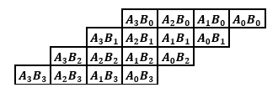
DESIGN OF 4X4 APPROXIMATE MULITPLIER
Consider two 4-bit numbers: A(A₃A₂A₁A₀) and B(B₃B₂B₁B₀)
The partial product matrix is as follows:
Four partial products, each of length 4-bit, are produced.
Fig.1 Partial product matrix of 4 × 4 multiplication

Slide 7
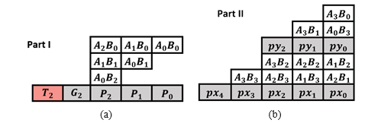
DIVISION OF PARTIAL PRODUCT MATRIX
The partial products matrix is divided into two parts, namely Part I and Part II, as shown below.
Fig.2 Part I and Part II of the partial product matrix

Slide 8
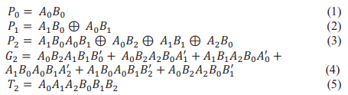
ANALYSIS OF PART I
The input variables in Part I are A₀, B₀, A₁, B₁, A₂ and B₂.
The corresponding six terms are used to generate the intermediate sum [T₂G₂P₂P₁P₀], as shown in Fig.2(a).
Thus, Part I requires 3 LUTs.
P₀,P₁ (4 shared variables): 1 LUT
P₂ (6 variables): 1 LUT
G₂ (6 variables): 1 LUT
T₂ (6 variables): 1 LUT => can be truncated

Slide 9
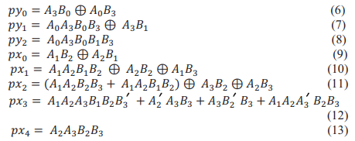
ANALYSIS OF PART II
The input variables in Part II are A₁, B₁, A₂, B₂, A₃ and B₃ for the outputs [px₄px₃px₂px₁px₀] and A₀, A₃, B₀, B₁ and B₃ for the outputs [py₂py₁py₀].
Thus, Part II requires 5 LUTs.
py₁,py₂ (5 shared variables): 1 LUT
px₀,px₁ (5 shared variables): 1 LUT
px₂ (6 variables): 1 LUT
px₃ (6 variables): 1 LUT
px₃ (6 variables): 1 LUT

Slide 10
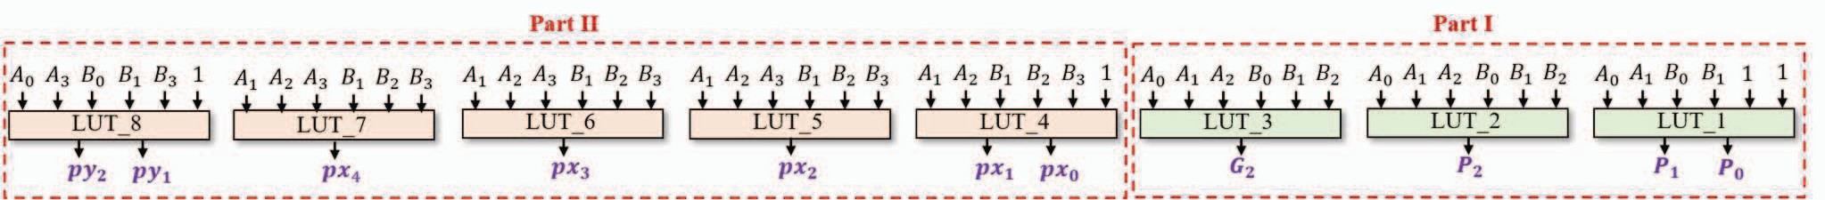
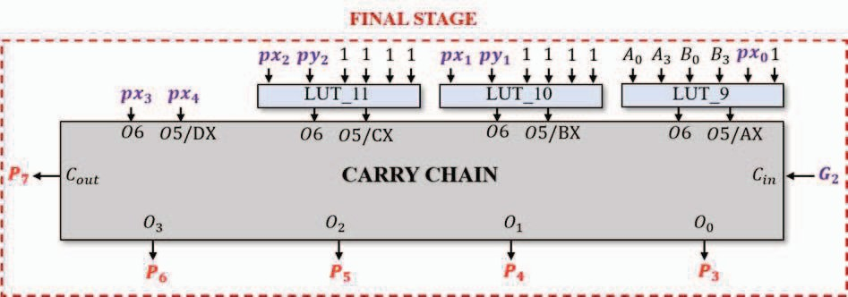
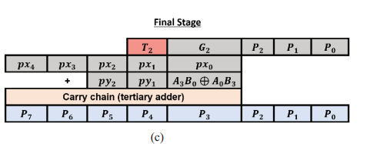
ANALYSIS OF FINAL STAGE
The proposed design uses 8-bit binary adder, instead of 8-bit ternary adder, thereby decreasing latency by 37%.
Thus, the final stage is implemented using 3 LUTs and a carry chain as binary adder with G₂ as C_{in}.
Fig.3 LUT-based implementation of Part I and Part II for proposed 4×4 approximate multiplier
Fig.4 Final Stage representation
Fig.5 Final Stage architecture of proposed approximate multiplier

Slide 11
APPROXIMATION
Removal of T₂ in the final stage calculation improves speed of the design by eliminating 1 LUT. Therefore, 11 LUTs are required for implementing the proposed 4x4 approximate multiplier.
However, when A₀, B₀, A₁, B₁, A₂ and B₂ all are fed logic 1 simultaneously, the output obtained is 10001. Since T2 had been truncated, hence an error of magnitude 16(10001-0001) is generated as a 5-bit output(T₂G₂P₂P₁P₀) can’t be represented accurately by a 4-bit output(G₂P₂P₁P₀).
To mitigate this problem, values of G₂ and P₂ have been reassigned as 1, instead of 0, when T₂ is 1, thus, minimising the error.

Slide 12

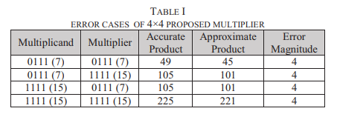
MODIFICATION IN EXPRESSION OF P₂ AND G₂
The Boolean expressions of P2 and G2 have been modified as follows:
The error magnitude gets reduced from 16 to 4(10001-1101).
This completes the entire design for the 4x4 approximate multiplier. On testing against all the 16x16=256 cases, error of magnitude 4 was found only in 4 cases, as shown in table I.

Slide 13
DESIGN OF HIGHER ORDER APPROXIMATE MULTIPLIER
Modular approach has been used to design higher order approximate multipliers.
This paper has discussed the design of 8x8 approximate multipliers, followed by their error analysis and implementation of image sharpening application.
Three approaches have been proposed for the design of 8x8 approximate multipliers, using the proposed 4x4 approximate multiplier.

Slide 14
APPROACH 1
4 instances of the proposed 4x4 approximate multiplier
2 instances of accurate 4-bit tertiary adder
Utilises 53 LUTs
Better performance than Ca [1], which uses 57 LUTs (4 instances of 4x4 multiplier proposed in [1] and accurate ternary adder)

Slide 15
APPROACH 2
Novel approximate adder has been used, to add the output of sub-multipliers.
The approximate adder, implemented using OR gates, adds the terms of same bit location into a 1-bit result without considering the carry-out from the previous bit location.
4 instances of proposed 4x4 approximate multiplier (11x4=44LUTs)
8 instances of novel approximate adder (1x8=8LUTs)
Utilises 52 LUTs
Better performance in comparison to Cc [1], which utilises 56 LUTs

Slide 16
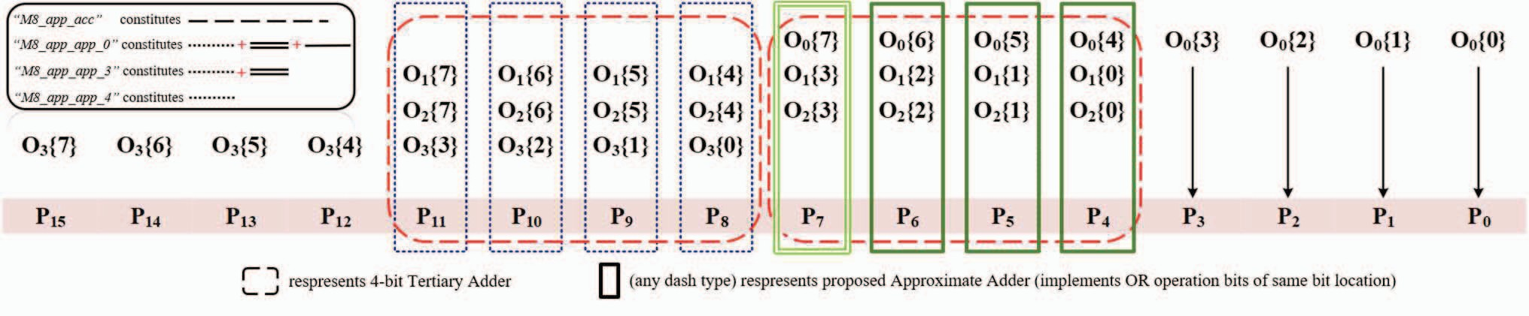
APPROACH 3
Approach 3(a): Utilises 45 LUTs
Approach 3(b): Utilises 44 LUTs
Most area-efficient approximate multiplier
Fig.5 8 × 8 approximate multiplier with estimated addition of sub-products.

Slide 17


ERROR ANALYSIS
Error analysis has been performed on the proposed 4x4 and 8x8 approximate multipliers based on following parameters.
Average Relative Error (ARE):
Average Error (AE):
Error Occurrences: Total number of inaccurate test cases
Maximum Error Magnitude: Maximum magnitude of error among all the error occurrences
Maximum Error Occurrences: Number of times the maximum error magnitude occurs

Slide 18
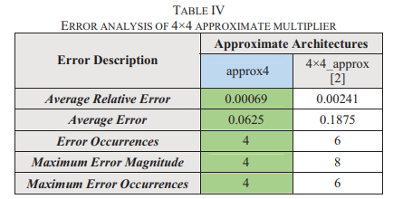
ERROR ANALYSIS OF PROPOSED 4X4 APPROXIMATE MULTIPLIER
Table II shows the error analysis of the proposed 4x4 approximate multiplier, in comparison with 4x4_approx[1].
TABLE II

Slide 19
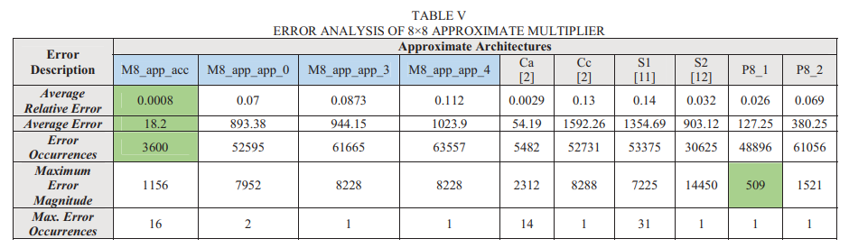
ERROR ANALYSIS OF APPROXIMATE 8X8 MULTIPLIERS
Table III shows the error analysis of the proposed three approaches of the 8x8 approximate multipliers.
TABLE III

Slide 20
PERFORMANCE ANALYSIS
Performance analysis has been performed on the proposed 4x4 and 8x8 approximate multipliers based on performance parameters such as:
LUT utilisation
Power
Latency

Slide 21
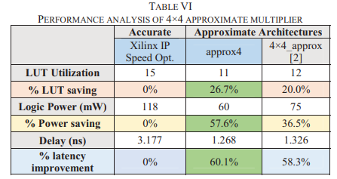
PERFORMANCE ANALYSIS OF 4X4 APPROXIMATE MULTIPLIER
Table IV shows the performance analysis of the proposed 4x4 approximate multiplier, in comparison with 4x4_approx[1].
The proposed 4x4 approximate multiplier has 26.7% LUT saving, 57.6% power saving and 60.1% latency improvement in comparison to Xilinx multiplier IP.
TABLE IV

Slide 22
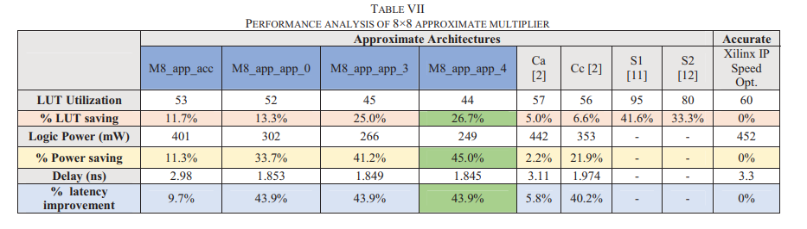
PERFORMANCE ANALYSIS OF 8X8 APPROXIMATE MULTIPLIERS
Table V shows the performance analysis of the proposed 4x4 approximate multipliers.
TABLE V

Slide 23
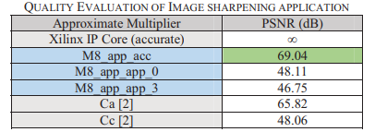
IMAGE SHARPENING ANALYSIS
To further evaluate the quality of the proposed 8x8 multipliers, image sharpening application has been implemented. The PSNR(peak signal to noise ratio) has been evaluated and compared. The results are shown in table VI. value are shown in table VI.
The PSNR values of the proposed approximate multipliers are well within the acceptable range. Higher the PSNR, better the image quality.
TABLE VI

Slide 24
CONCLUSION
A 4x4 approximate multiplier has been proposed, which utilises 11 LUTs.
Higher order multipliers (8x8) have been implemented using the proposed 4x4 approximate multiplier.
Error analysis showed that the proposed approximate multipliers are successful in reducing the error magnitude.
Performance analysis showed that the proposed approximate multiplier out performed the state-of-the-art multipliers, in terms of LUT utilisation, power and latency.
The computation of PSNR values validated that the proposed approximate multipliers can be used for error-resilient applications.

Slide 25
REFERENCE
[1] https://ieeexplore.ieee.org/abstract/document/9344673

